Slide 1
COMP6115 Object Oriented System Analysis and Design DIGITAL CONTENT Session # 3

Slide 2
Learning Objective
Understands various basic aspects of Requirements Analysis such as its definition, process, and various requirements analysis techniques.

Slide 3
COMP6115 Object Oriented System Analysis and Design DIGITAL CONTENT: Requirement Determination Session # 3

Slide 4

What is the Requirements Analysis?
Is a process of defining the expectations of the users for an application that is to be built or modified

Slide 5
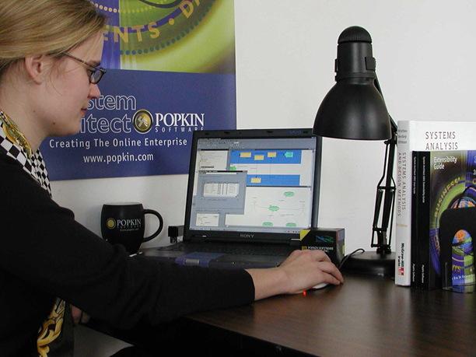
Requirement Analysis Steps
Eliciting requirements
Analyzing requirements
Requirements modeling
Review and retrospective

Slide 6
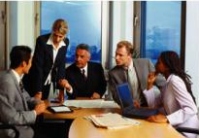
Requirements Analysis Techniques
Unified Modeling Language
Business process modeling notation
Flowchart technique
Data flow diagram
Role Activity Diagrams
Gantt Charts
Integrated Definition for Function Modeling
Gap Analysis

Slide 7
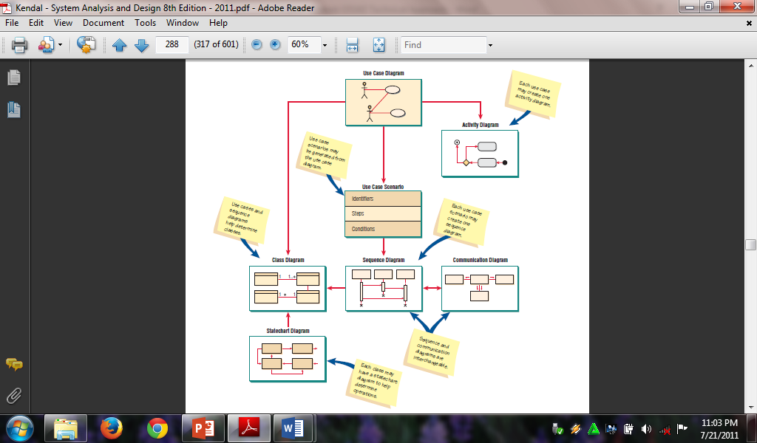
Unified Modelling Language

Slide 8
References:
https://reqtest.com/requirements-blog/requirements-analysis/
(Source: ReQtest 25th October 2018)

Slide 9
Acknowledgement
This digital content has been developed by the Faculty Member of SCS in Advanced Software Engineering to give an illustration of the Object Oriented System Analysis and Design.

